Slide 1
3
C
B
4
α₂
2
ω₂
4
1
D
A

Slide 2
Consider the equivalent mechanism
3
C
B
4
α₂
2
ω₂
4
1
D
A

Slide 3
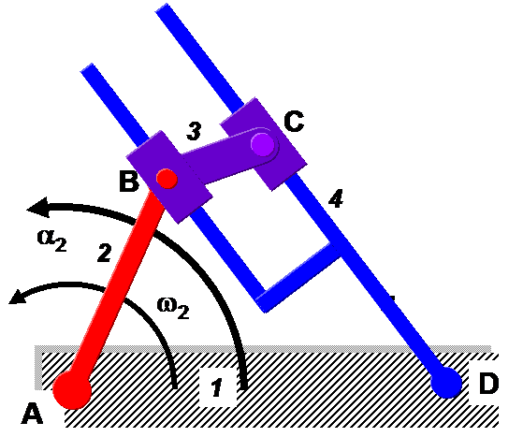
V_{B2} = ω₂XAB
V_{B3} = V_{B2}
V_{B4} = V_{B3} + V_{B4B3}
V_{B4} = ω₄XDB
V_{C4} = V_{C3} + V_{C4C3}
V_{C4C3} = V_{C4C3s}
Velocity vector lines are perpendicular or parallel to lines, indicating the displacement vectors, appearing on the mechanism. Diagram is schematic, not to scale
C₃
B₃, B₂
V_{C3B3}
V_{B2} = ω₂XAB
O_{V}
V_{C4C3}
V_{B4B3}
V_{C4}
C₄
V_{B4}
B₄

Slide 4
a_{B2,n} = ω₂²AB
a_{B2t} = α₂AB
a_{B2,} = a_{B3} = a_{B2,n} + a_{B2,t}
a_{B4} = a_{B4n}+ a_{B4t}= ω₄²DB + α₄DB
a_{B3} = a_{B4} + a_{B3B4}
= a_{B4n}+a_{B4t}+ a_{B3B4n}+ a_{B3B4t}
= a_{B4cen}+a_{B4ang}+ a_{B3B4s}+ a_{B3B4cor}
a_{B3B4cor} = 2ω₄V_{B3B4s}
Magnitudes and directions of all ω s are available from velocity diagram. C is found once unknowns are obtained by finding B.
C₃
a_{C3B4 cor}
a_{B3B4 cen}
O_{a}
a_{B3B4 cen}
a_{B2}
a_{B4,n}
a_{B2,n}
a_{C4,n}
B₃ , B₂
a_{B2,t}
a_{B3B4 cor}
a_{C3C4 s}
a_{C4,t}
a_{B4,t}
a_{B3B4 s}
C₄
====== normal component
_______ tangential component
Diagram is schematic, not to scale
B₄

